Slide 1
Annual review – year 1
Matthew Lee
Medical Research Council Integrative Epidemiology Unit
Wednesday, 21 November 2018

Slide 2
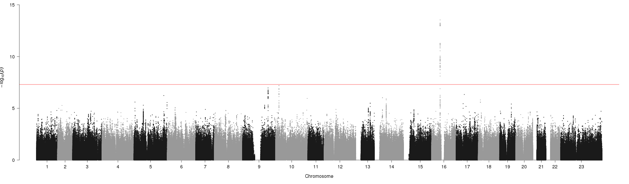
Genome wide association study of glycosuria
Performed GWAS using ALSPAC data - lead SNP = rs13337037
OR: 1.42; 95% CI: 1.29 - 1.55; P = 2.88 x 10⁻¹⁴
Independently tested association in NFBC
OR: 1.25; 95% CI: 1.10 - 1.43; P = 9.8 x 10⁻⁴
Performed meta-analysis - lead SNP = rs13337037
OR: 1.38; 95% CI: 1.30 - 1.45; P = 3.09 x 10⁻¹⁶
Notes:
Glycosuria is an intermediate phenotype and screening tool for gestational diabetes.
Patients who develop gestational diabetes are at increased risk of gestational diabetes in future pregnancies, and at risk of developing type 2 diabetes over the life-course
So we set out to identify genetic variants associated with glycosuria, to better understand disease development, progression, and related complications
ALSPAC; n case/control = 1352/5333 = 6685
NFBC1986; n cases/controls = 747/2991 = 3738
meta-analysis n cases/controls = 2099/8324 = 10423

Slide 3
Genome wide association study of glycosuria
 |  |  | Glycosuria and traits |  |  |  | Lead SNP and traits
Trait | n | n_cases | beta | 95%_CI_lower | 95%_CI_upper | P_value | beta | 95%_CI_lower | 95%_CI_upper | P_value
Stix test | 7176 | 282 | 3.83 | 3.39 | 4.26 | 6.84E-67 | 0.50 | 0.32 | 0.68 | 2.82E-08
BMI | 6544 |  | 0.91 | 0.67 | 1.14 | 3.80E-14 | 0.18 | 0.03 | 0.32 | 1.64E-02
Underweight | 284 | 6260 | -0.08 | -0.28 | 0.11 | 0.6 | -0.03 | -0.22 | 0.16 | 0.7
Normalweight | 4934 | 1610 | -0.33 | -0.47 | -0.19 | 5.13E-06 | -0.07 | -0.16 | 0.02 | 1.19E-01
Overweight | 994 | 5550 | 0.23 | 0.06 | 0.40 | 6.66E-03 | 0.08 | -0.03 | 0.18 | 1.54E-01
Obese1 | 230 | 6314 | 0.49 | 0.19 | 0.80 | 1.41E-03 | 0.08 | -0.13 | 0.28 | 4.71E-01
Obese2 | 102 | 6442 | 0.88 | 0.46 | 1.31 | 5.27E-05 | 0.12 | -0.18 | 0.43 | 4.23E-01
Frequency of water drunk in one week | 5764 |  | 0.00 | -0.13 | 0.13 | 9.98E-01 | 0.11 | 0.03 | 0.18 | 6.84E-03
Thrush (ever) | 1264 | 3556 | 0.01 | -0.04 | 0.25 | 9.28E-01 | -0.08 | -0.18 | 0.02 | 1.35E-01
Thursh (pregnancy) | 828 | 5857 | 0.22 | 0.04 | 0.39 | 1.43E-02 | -0.07 | -0.18 | 0.05 | 2.67E-01
Urinary infection (ever) | 1845 | 2901 | 0.03 | -0.12 | 0.18 | 7.16E-01 | -0.05 | -0.14 | 0.04 | 2.97E-01
Urinary infection (pregnancy) | 6314 | 371 | 0.86 | 0.64 | 1.08 | 2.16E-14 | -0.13 | -0.30 | 0.04 | 1.44E-01
Urinating at night | 2703 | 2132 | 0.08 | 0.03 | 0.13 | 2.05E-03 | -0.01 | -0.04 | 0.02 | 4.43E-01
Hypertension (ever) | 5848 | 986 | 0.46 | 0.30 | 0.62 | 2.61E-08 | 0.04 | -0.07 | 0.14 | 5.12E-01
Hypertension (pregnancy) | 275 | 702 | -0.16 | -0.47 | 0.16 | 3.38E-01 | -0.05 | -0.28 | 0.17 | 6.31E-01
Gestational hypertension | 6233 | 1063 | -0.16 | -0.47 | 0.16 | 3.38E-01 | -0.05 | -0.28 | 0.17 | 6.31E-01
Preeclampsia | 7296 | 162 | 1.16 | 0.81 | 1.51 | 7.86E-11 | 0.15 | -0.09 | 0.39 | 2.31E-01
Notes:
We performed linear or logistic regression on a number of traits for individuals with available genetic data and i’ve highlighted some here
We see the questionnaire correlates highly with the clinical measure for glycosuria and our lead SNP also correlates with the clinical measure
Also a correlation with glycosuria and BMI and a negative correlation with BMI classified as normal weight
For the lead SNP we see a positive correlation with frequency of water drunk in one week – which if the SNP is associated with glycosuria which is an intermediate phenotype towards type 2 diabetes would make sense because people with type 2 diabetes are advised to drink more

Slide 4
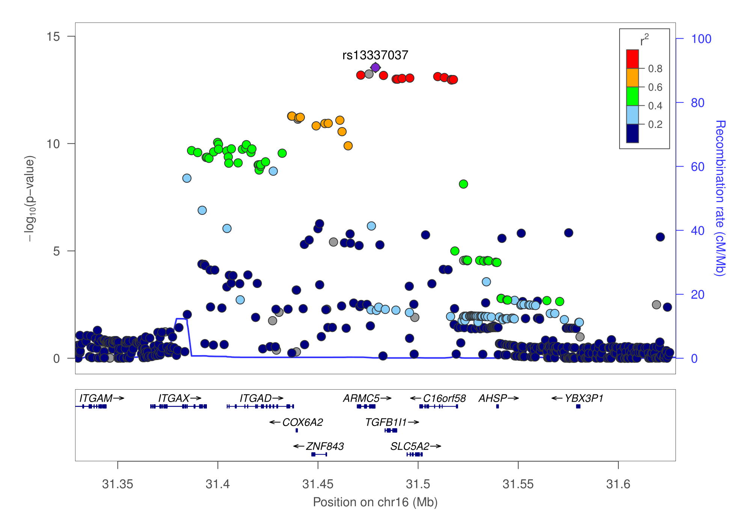
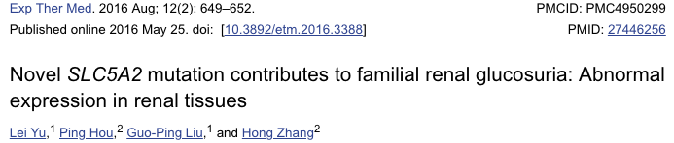
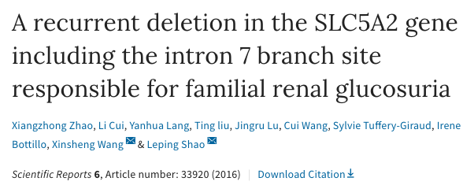
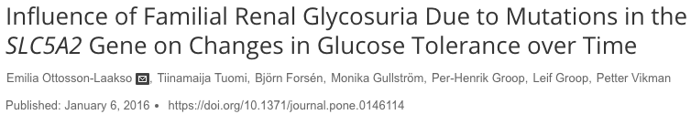
Genome wide association study of glycosuria
Notes:
We find that the lead SNP, along with a number in high LD that we also find reach genome wide significance in our study, is near a gene which for which mutations in lead to familial renal glycosuria.
The gene is a drug target for type 2 diabetes
SLC5A2 encodes for sodium glucose co-transporters which mediate glucose reabosrption in the kidney – diabeteics have increased levels of SGLT2 and the drugs act to inhibit SGLT2 and improve glycaemic control by excretion of sugar to urine

Slide 5
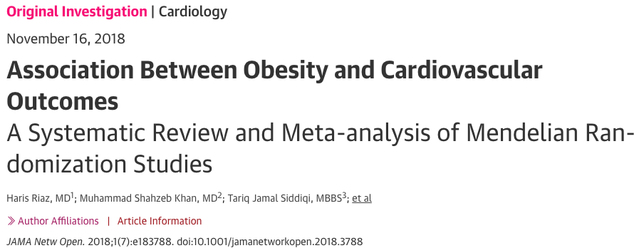
Chapter 1 - systematic review
 | MR terms | Adiposity terms | MR & Adiposity
Medline | 8,001 / 42,142 | 1,668,470 | 1,058 / 3,469
Embase | 14,164 / 37,037 | 1,557,903 | 1,928 / 3,564
BiorXiv | 564 | - | 564
Titles screened | Full text | Review | Meta-analysis
2,511 | 27 | 7 | 5
Inclusion
BMI or WHRadjBMI
& CAD, stroke, T2D
& OR with 95% CI
Results (1SD higher BMI)
T2D: OR 1.67 (1.3-2.1); P < 0.001; I² = 93%; n = 461 871
CAD: OR 1.20 (1-1.4); P = 0.03; I² = 87%; n = 570 261
Stroke: OR 1.02 (1-1.1); P = 0.65; I² = 0%; n = 228 816
Notes:
The first chapter of my thesis will predominantly be a systematic review of MR studies using adiposity as an exposure.
I’m working with Luke McGuinness, a research associate with Julian Higgins, to conduct the review.
I have so far completed the search strategy and analysis plan which has been pre-registered with PROSPERO - Prospective Registration of Systematic Reviews
We are searching Medline, Embase, and BiorXiv.
People may be doing MR but not calling it MR, so this is why we have two numbers for identified studies here – the first includes MR and causal analysis/inference where as the second also includes genetic epidemiology terms and picks up a lot of GWAS studies.
We expect about a third overlap between the two databases so around 4,000 abstracts to screen including BiorXiv.
BiorXiv has a terrible search function so the best way to undertake the search here is to use 4 different terms (MR, causal analysis/inference) and screen them all
Last friday a systematic review and meta-analysis came out thats quite similar to ours
However their inclusion is quite restrictive and they do only actually look at BMI in their formal analysis due to a lack of WHR studies they include
And they also only look at 3 outcome
Kaitlin has an editorial with George that came out at the same time which basically says this too
Our study differs in that we aim to establish a comprehensive overview of MR and adiposity looking at all adiposity measures as exposures and all outcomes

Slide 6
Adiposity and metabolites – Peter Wurtz
82 metabolic measures (NMR)
Triangulation approach
Observational (bi-directional)
MR (weighted genetic risk score; 32 SNPs)
Weight change
Obs and MR do not significantly differ (p > 0.0005)
MR estimates
Positive: VLDL and LDL lipids, branched-chain and aromatic amino acids, inflammatory markers, leptin, insulin, and blood pressure.
Inverse: Large HDL lipid concentration, HDL particle size, sex hormone–binding globulin.
Notes:
NMR of 82 metabolic measures – 67 metabolic measures represent broad metabolic signature of systemic metabolite profile, 15 additional measures inc inflammatory markers and hormones
Cross sectional association of BMI and 82 metabolic measures
Causal effects of adiposity on the metabolic profile
Weight change and metabolic response
32 SNPs from Speliotes 2010
My PhD is looking at BMI and measures of adiposity and how these associate differently with intermediate phenotypes, specifically metabolites, and how this leads to and/or effects disease
And this is kind of building and expanding on Peter Wurtzs work from 2014 where i think theyre the first to look at BMI and metabolites
Specifically they look at 82 metabolic measures (67 metabolites and 15 additional measures) using this triangulation approach of:
observation in white, MR in orange, and weight change in green
They find little difference between the observational and the MR estimates
And strong associations

Slide 7
Measures of adiposity and metabolites – step one
Mass spec
452/275
Nuclear Magnetic Resonance
123
BMI
WHR
BF
P < 0.05
Notes:
So what ive been doing is building up a data library of different measures of adiposity and associations with metabolites.
Here im showing mass spec and NMR results, for mass spec theres a number of unknown metabolites so this figure only shows the known ones
and the figures show BMI on the outer ring and then waist hip ratio and body fat % with red circles indicating a p value of less than 0.05
And ive ordered the figure alphabetically by metabolite category, so amino acid, carbohydrate and so on and then within each category ordered by the effect size of BMI on metabolite from highest to lowest
Mass spec:
452 including unknown metabolites – 275 without unknowns
1. Amino Acid; 2. Carbohydrates; 3. Cofactors and Vitamins; 4. Energy; 5. Fatty Acid; 6. Lipid; 7. Nucleotide; 8. Peptide; 9. Xenobiotics
NMR:
123 metabolites
1. Amino Acid; 2. Carbohydrates; 3. Energy; 4. Fatty Acid; 5. Keto Acid; 6. Lipid; 7. Metabolite Salt; 8. Metabolites ratio; 9. Protein

Slide 8
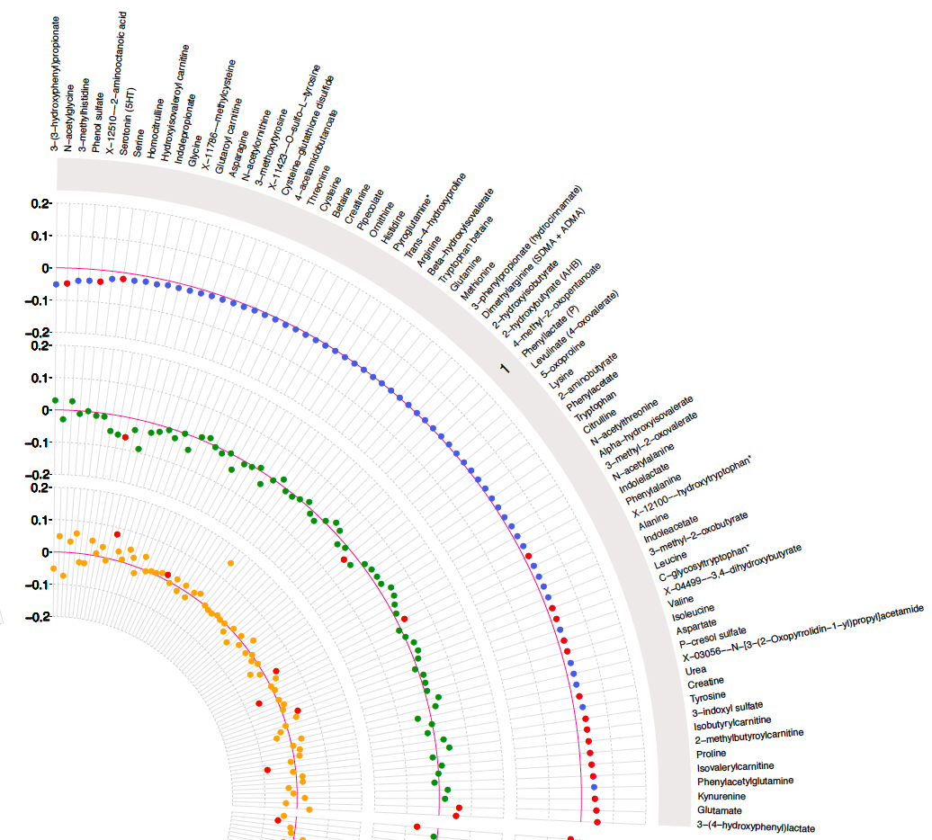
Notes:
And then blown up you can see a bit clearer

Slide 9
Measures of adiposity and metabolites – step-two
Metabolite SNPs
Disease
Notes:
So that is step-one essentially, looking at BMI and adiposity and metabolites
Then we want to look at how these metabolites associate or mediate the effect of BMI on disease
And I dont really have a clear idea of how to go about this yet so essentially you have this dataset of associations and then somehow decide which are interesting or biologically relevant and then extract instruments for those metabolite to then look at with disease
And this is something that will progress over the second half of this year and into my third year

Slide 10
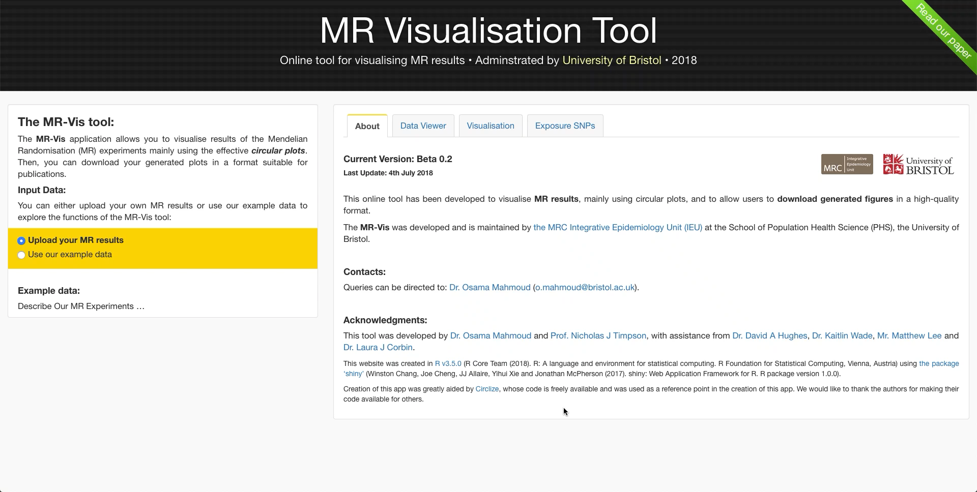
MR visualisation tool
Notes:
One of the difficulties of working with metabolites and omics data in general is the scale.
So ive been working with Osama Mahmoud and others in the group to develop a platform which will produce meaningful visualisations, a way to organise data and extract instruments from outcomes, and in the future perform sensitivity analysis and flag this up to the user
This is the current state of the platform now and I’m going to catch-up with Osama at the end of December
But this is something we see as initally benefitting the group and that can then be of benefit to the community, much like MR Base

Slide 11
Ongoing and future work
Tim Frayling work
Favourable adiposity & BMI
GRS -> metabolites
Flemish Gut Flora Project
Observational analysis
Prediction using GRSs
One-sample MR
Metabolite profile/groupings
Factor analysis
Partial least squares
Biological priors
Notes:
The other work im doing at the moment and that will continue into my second year is:
Work with Tim Frayling looking at favourable adiposity and BMI and how they differ in terms of association with metabolites
We expect to see a difference between the two, and that the favourable adiposity GRS will associate with a favourable lipid fraction
So far I’ve created the GRSs and will start performing the MR analysis next week
I’m also working on data from the Flemish Gut Flora Project whcih is a large faecal microbiome study with extensive phenotypic and genetic data
Im going to be looking observationally to describe the metabolite data and then to begin using different genetic risk scores for BMI for prediction of metabolic profile
Finally i’ll look at BMI and metabolites in a one-sample MR framework where i can look at confounders that we cant look at in two sample MR
Finally, and this is longer term, but im interested in how we look at metabolites as the intermediate phenotype and whether we can group or look at them as a whole and then what this means for interpretation of assoctaions
And ive spoken with Kate Tilling about how best to go about this and shes given me some ideas of places to start with factor analysis and partial least squares.
But this is something i think will take time and will develop as my PhD progresses – because at the moment i dont really understand how either of those works and what that would mean for interpreting results

Slide 12
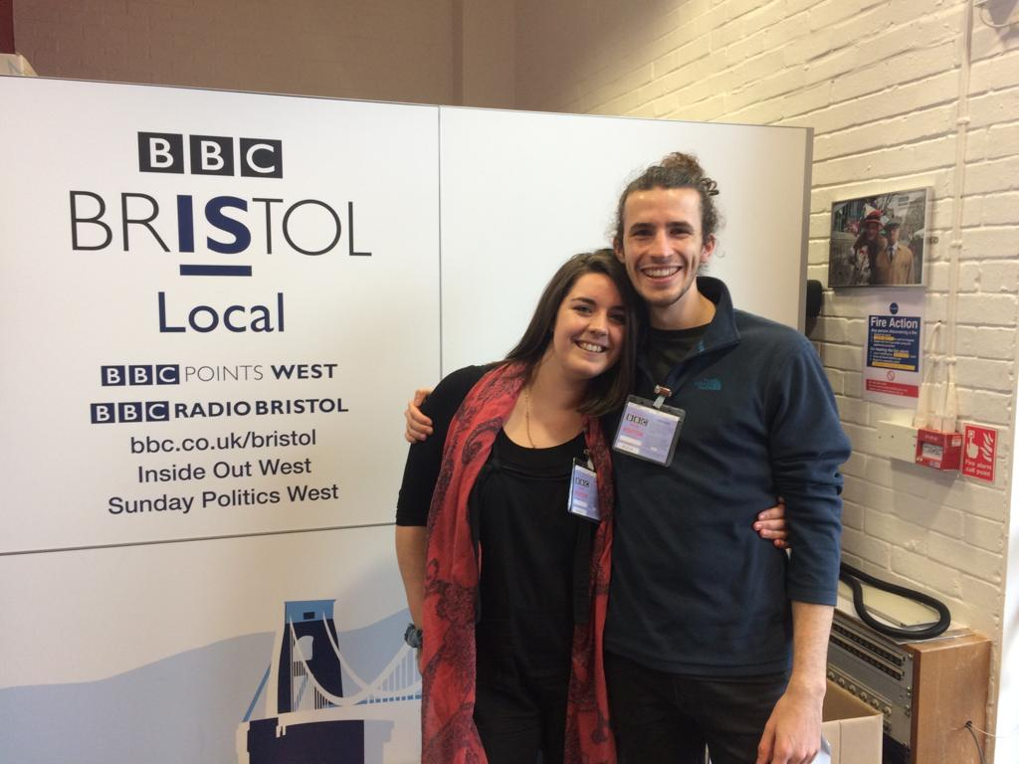
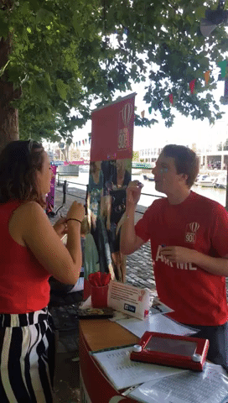
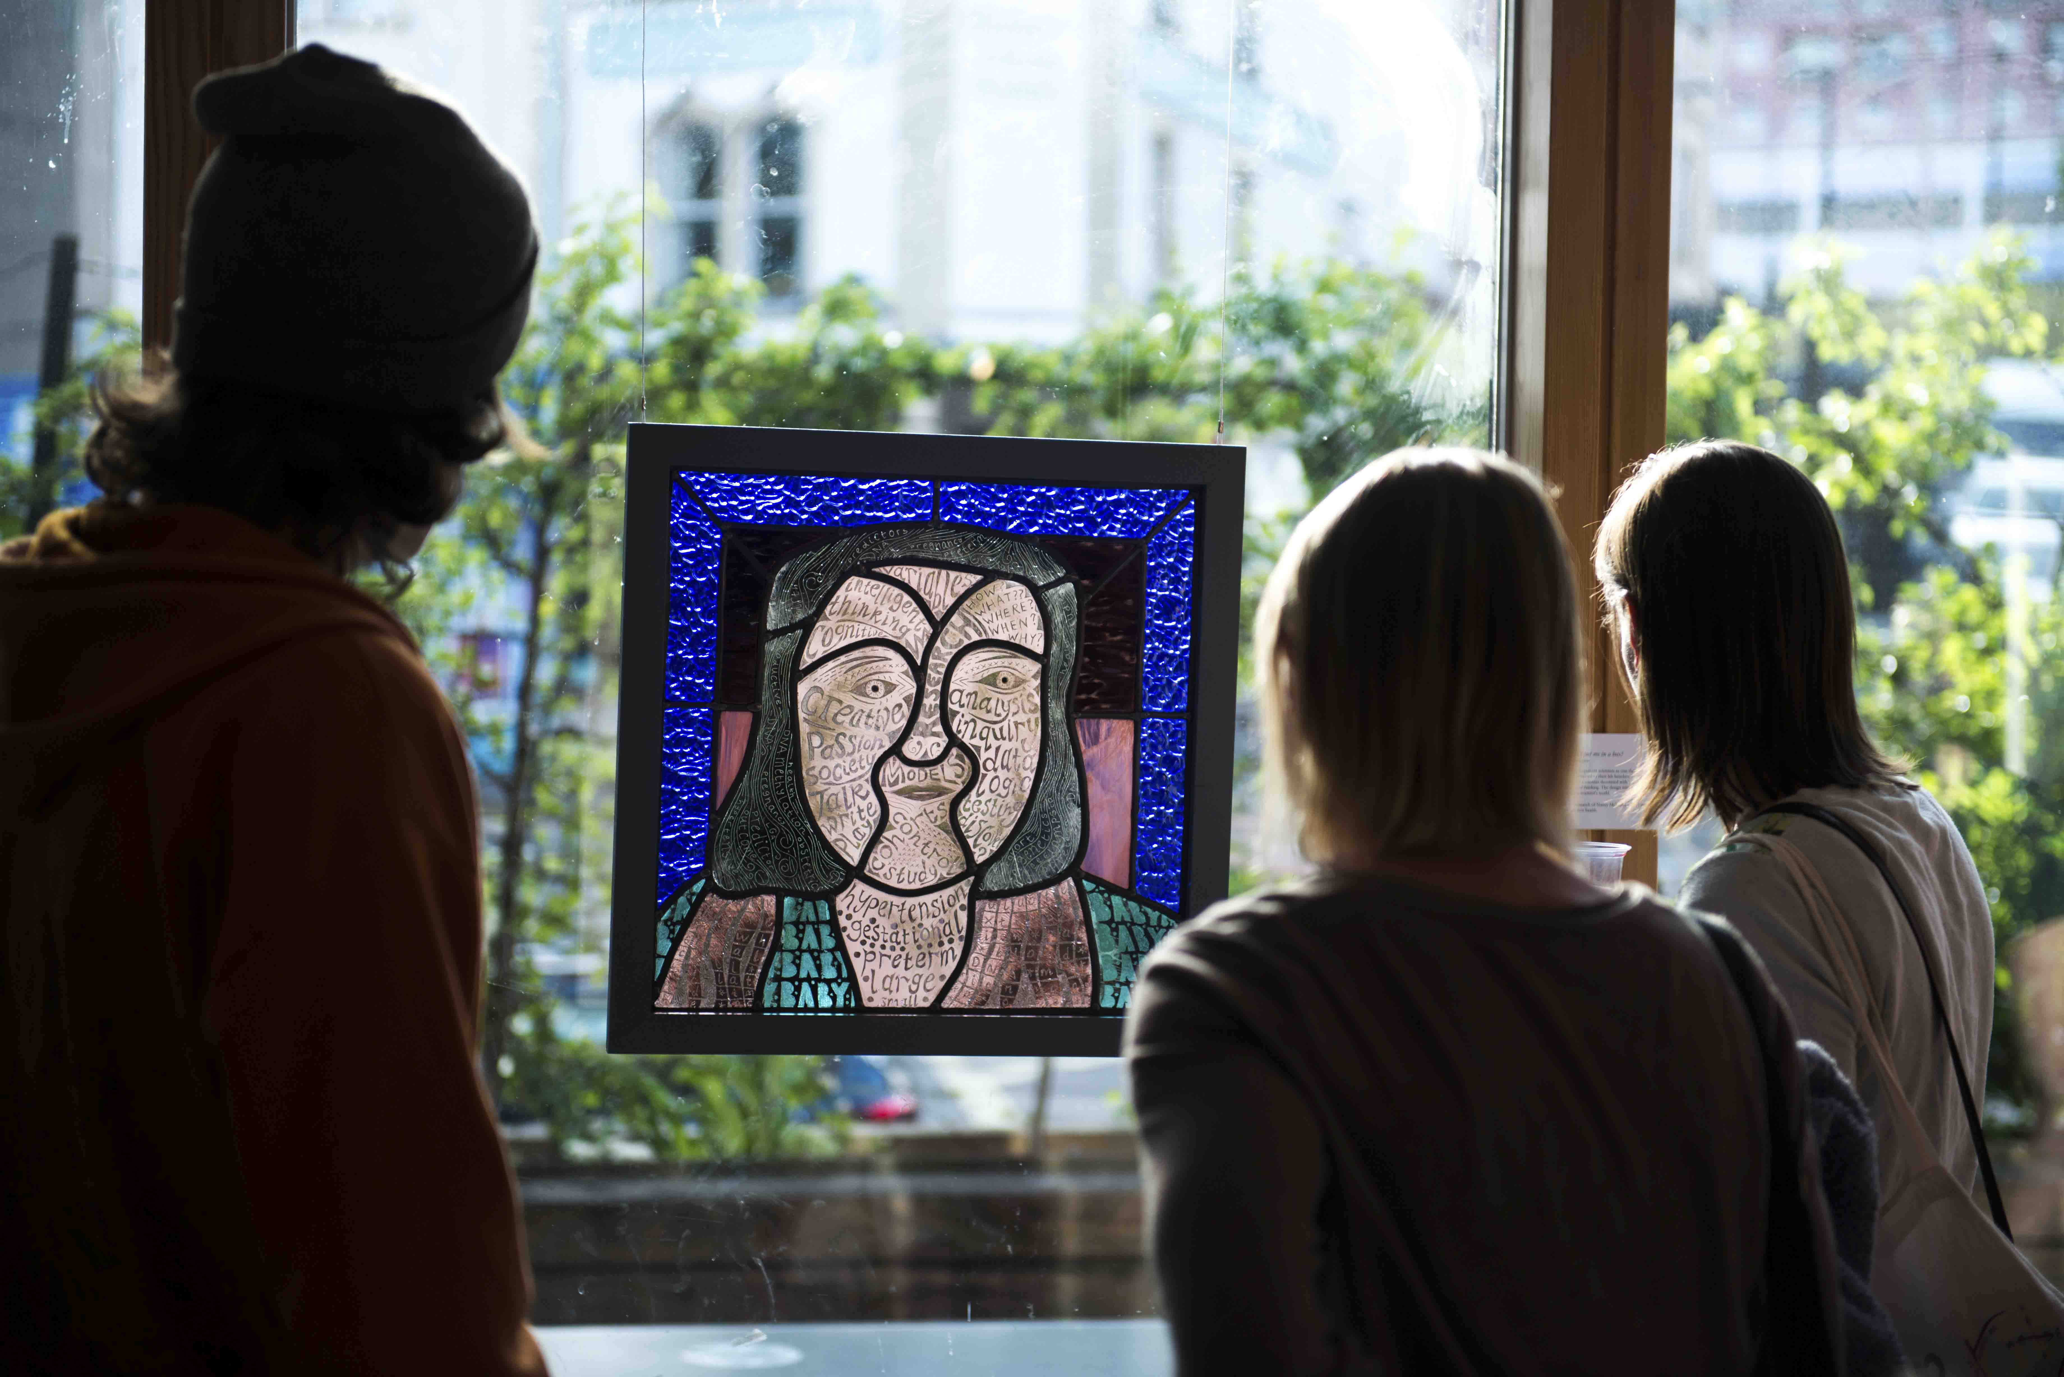
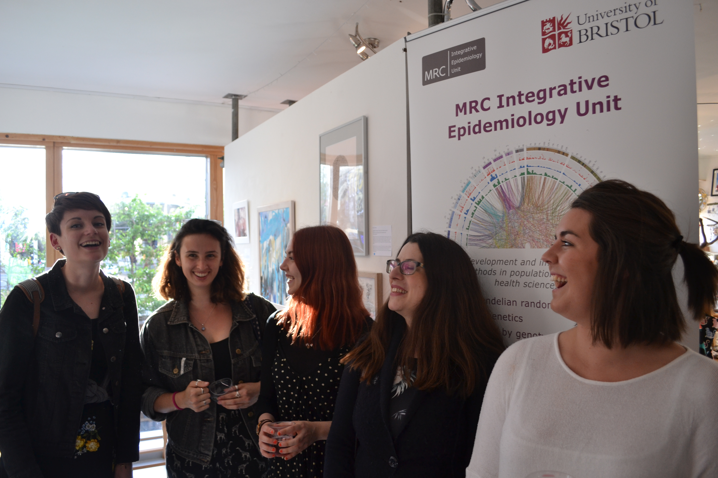
Training etc.
Courses year 1
stats / R / STATA / Linear & Logistic regression / MR / Linux / programming
Courses year 2
Mediation analysis / Genetic epidemiology / Multiple imputation / Repeated measures
Posters/presentations
GW4 congress (poster/talk) / Pop Health Science Symposium (poster) / GW4 orientation (talk)
Public engagement
Notes:
And then ive done a lot of training this year and these are some of the courses ive been on and ones ill be attending this coming year
Ive done a few posters and presentations
And some public engagment lke going on BBC Bristol and organising an art exhibition.

Slide 13

Acknowledgements
Kaitlin Wade David Hughes Charlie Hatcher
Laura Corbin Osama Mahmoud Nancy McBride
Nic Timpson Luke McGuinness Tom B

Slide 14
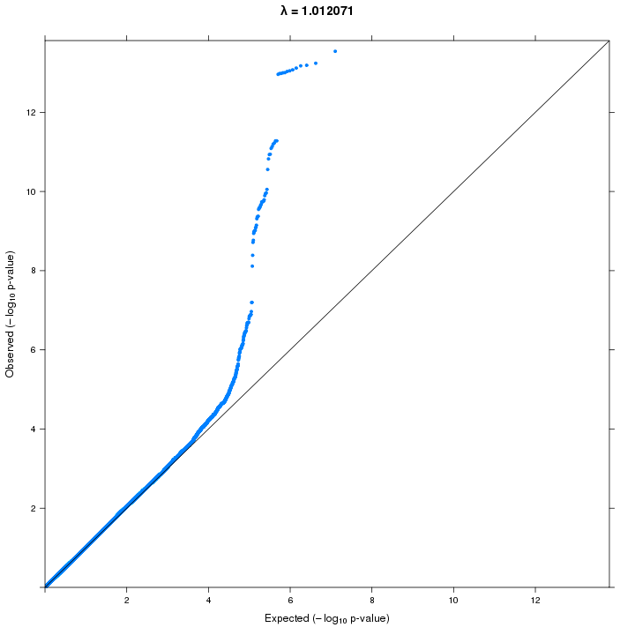
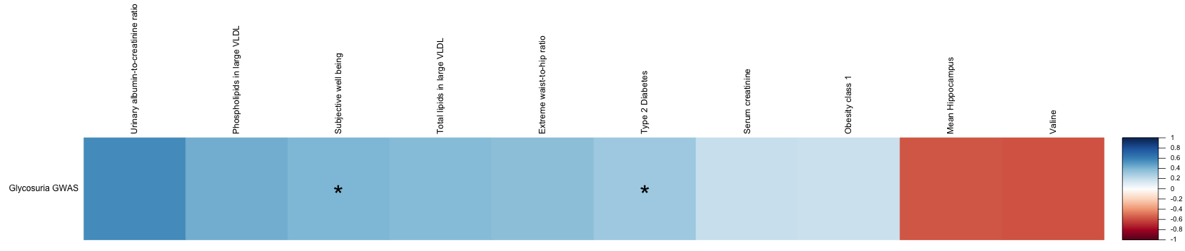
GWAS

Slide 15
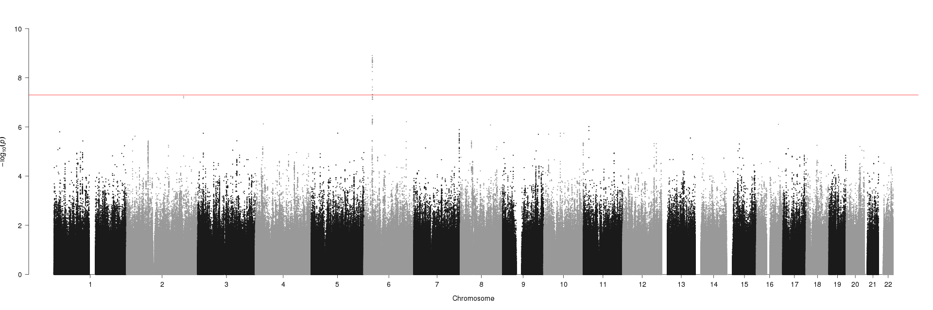
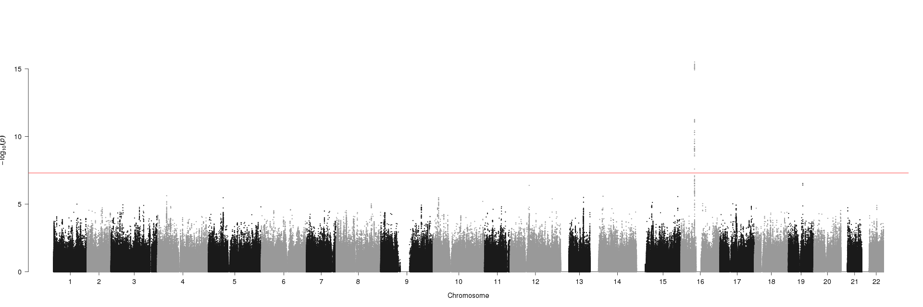
GWAS

Slide 16
Mendelian randomization
C
The IV is associated with X
The IV is independent of confounders
The IV is independent of the outcome (Y) conditional on the exposure X (and confounders; C)
X
G
X
Y
X
Homogeneity, monotonicity, no interaction
The effect is homogeneous across the population
The instrument-exposure association is always in the same direction or null
The instrument doesn’t interact with confounders in terms of its effect on your exposure

